Slide 1
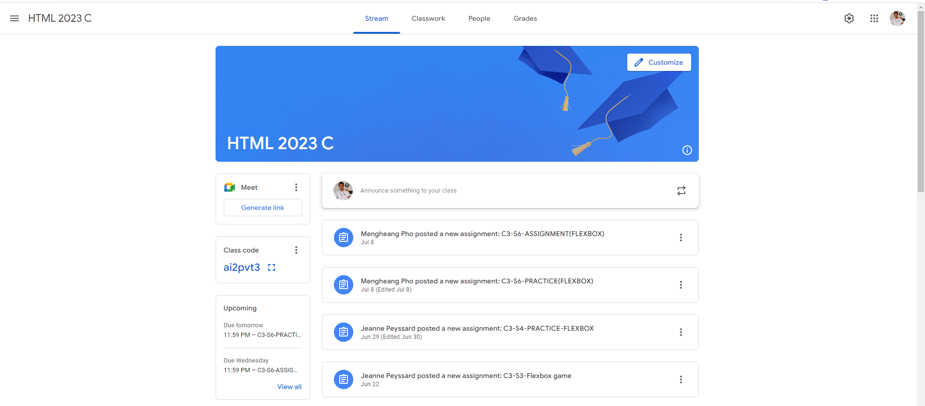
Identify root components of website below

Slide 2
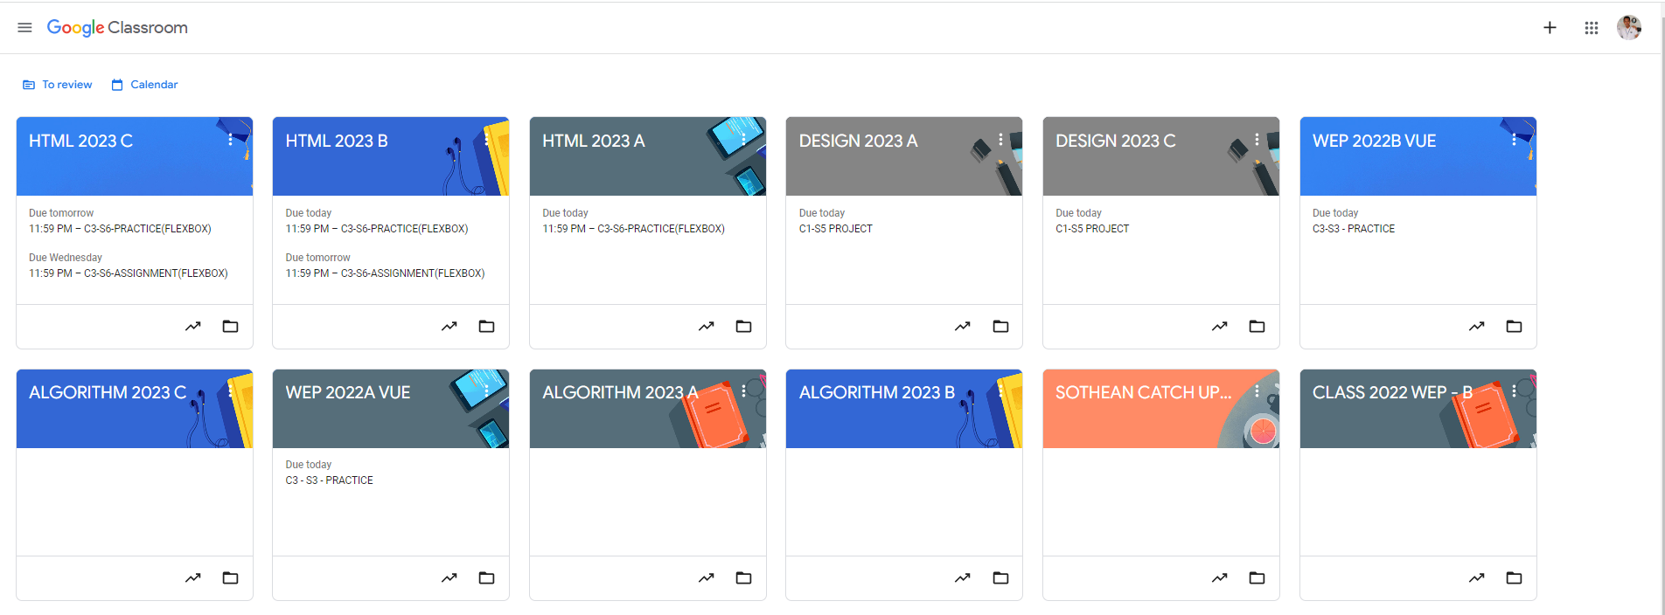
Root div
- Height: 100vh
content
nav
Flex: 0
header
Flex: 0
Flex: 1

Slide 3

nav
content
Flex: 0
header
Flex: 0
Flex: 1

Slide 4
Flex-direction: row
Header-left
Header-center
Header-right
Flex: 1
Flex: 3
Flex: 2

Slide 5

Flex: 0
Flex: 1
Main – sidebar
Main- content
Flex-direction: row

Slide 6
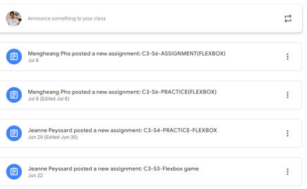
Flex-direction: column
Flex: 1
Contain-Title
Item
Item
Item
Item

Slide 7
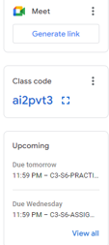
Flex-direction: column
Item
Flex: 0
Item
Flex: 0
Items
Flex: 1

